Slide 1
Lectuer-12 Database Design and Applications
Ashish Narang

Slide 2
First Semester
2020-21

Slide 3
Contents
Why a System Fails
Purpose of Database Recovery
Log Based Recovery
Checkpoints
Recovery based on deferred update
Recovery based on Immediate update
Shadow Paging

Slide 4
Databases Recovery
A computer system is subjected to failure due to variety of reasons:
Power failure
Software error
Catastrophic failure
The db system must take actions in advance to ensure that system can restore the past copy of database that was backed up.
Recovery scheme is an Integral part of db system that can restore the db to consistent state even because of failure.

Slide 5
Purpose of Database Recovery
To bring the database into the last consistent state, which existed prior to the failure.
To preserve transaction properties (Atomicity, Consistency, Isolation and Durability).
Example:
–If the system crashes before a fund transfer transaction completes its execution, then either one or both accounts may have incorrect value. Thus, the database must be restored to the state before the transaction modified any of the accounts.

Slide 6
Types of Failure
The database may become unavailable for use due to
Transaction failure
System failure
Media failure

Slide 7
Contd..
Transaction failure: Transactions may fail because of incorrect input, deadlock, incorrect synchronization.
There are two types of errors that may cause a transaction to fail
– logical error
– system error

Slide 8
Contd..
Logical error
–The transaction can no longer continue with its normal execution owing to some internal condition such as bad I/P, data not found, overflow, or resource limit exceeded.
System error
–The system has entered an undesirable state (deadlock) as a result of which a transaction can not continue with its normal execution.
– The transaction, however, can be re-executed at later time.

Slide 9
Contd..
System failure: System may fail because of addressing error, application error, operating system fault etc.
Media failure: Disk head crash etc.

Slide 10
Log Based Recovery
The most widely used structure for recording database modifications is the log.
Log maintains a record of all the update activities in the db.

Slide 11
Transaction Log
For recovery from any type of failure data values prior to modification (BFIM - BeFore IMage) and the new value after modification (AFIM – AFter IMage) are required.
Each log record describes a single database write operation and contains the following details.
Transaction name
Data item name
Old value
New value

Slide 12
Contd..
< Ti start> - indicates transaction Ti started
<Ti, Xj, V1, V2> - transaction Ti has performed a write
operation on data item Xj and Xj has value V1 before the write and will have value V2 after the write.
<Ti commit > - transaction Ti commits.
<Ti aborts > - transaction Ti aborts.
With these log records we have the ability to undo or redo a
modification that has already been output to the DB.

Slide 13
Transaction Roll-back (Undo) and Roll-Forward (Redo)
To maintain atomicity, a transaction’s operations are redone or undone.
Undo: Restore all BFIMs on to disk (Remove all AFIMs).
Redo: Restore all AFIMs on to disk.
Database recovery is achieved either by performing only Undos or only Redos or by a combination of the two.

Slide 14
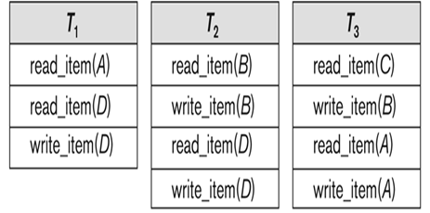
Contd..

Slide 15
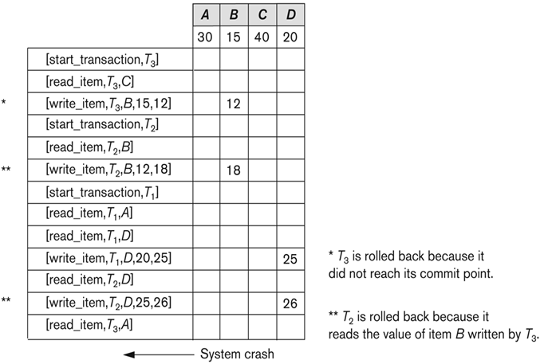
Contd..

Slide 16
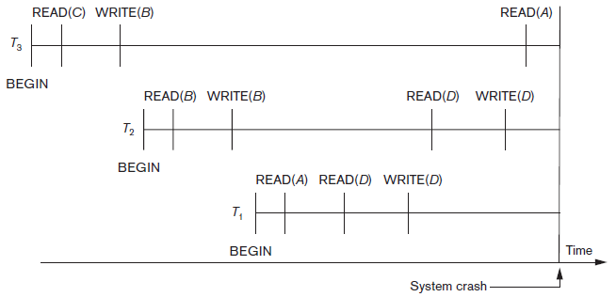
Contd..

Slide 17
Check Pointing
In case of failure, the log needs to be searched to determine the transactions that need to be redone or undone.
But this search is time consuming and most of the time the algorithm will redo the transactions which actually written their updates to the DB, redoing them is waste of time.
In order to reduce these types of overheads check pointing is helpful.

Slide 18
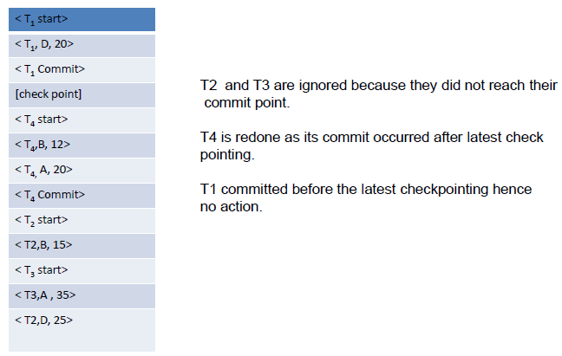
Contd..

Slide 19
Sequence of actions in check pointing
Suspend execution of transactions temporarily.
Output all log records currently in main memory onto stable storage.
Output all modified buffer blocks to the disk.
Output log record <check point> on to stable storage.
Resume executing the transactions.

Slide 20
Deferred Update (No Undo/Redo)
The data update goes as follows:
–A set of transactions records their updates in the log.
–At commit point these updates are saved on database disk.
–After reboot from a failure the log is used to redo all the transactions affected by this failure. No undo is required because no AFIM is flushed to the disk before a transaction commits.

Slide 21
Deferred Update in a single-user system
There is no concurrent data sharing in a single user system. The data update goes as follows:
–A set of transactions records their updates in the log.
–At commit point these updates are saved on database disk.
After reboot from a failure the log is used to redo all the transactions affected by this failure. No undo is required because no AFIM is flushed to the disk before a transaction commits.

Slide 22
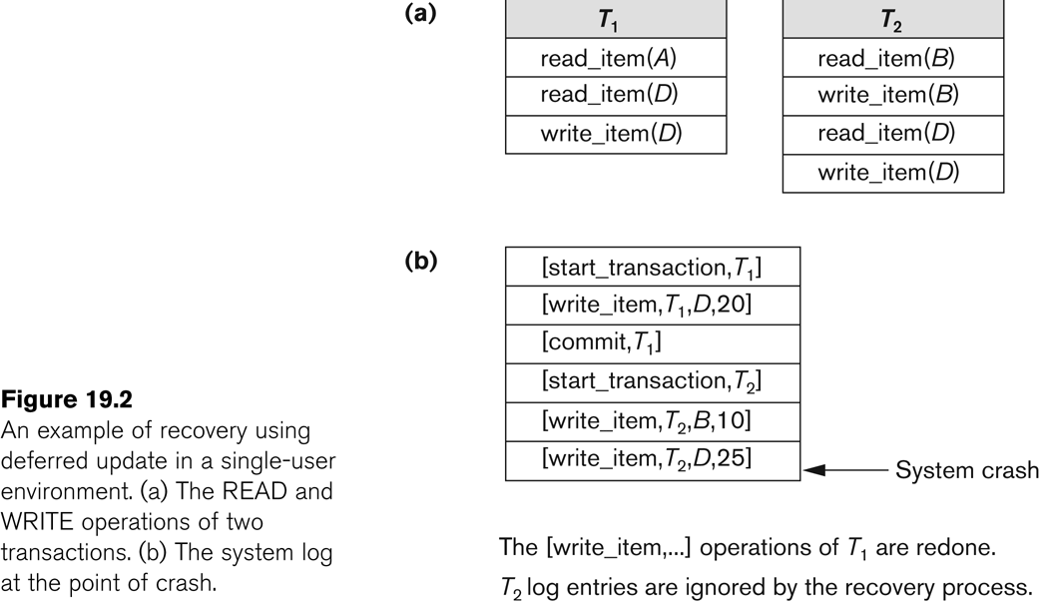
Contd..

Slide 23
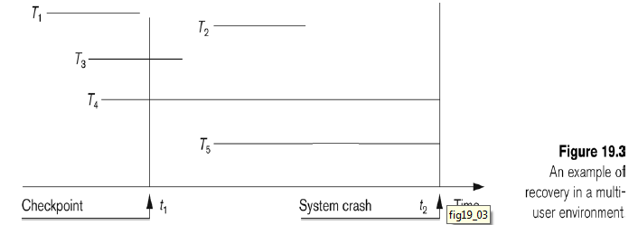
Deferred Update with concurrent users
This environment requires some concurrency control mechanism to guarantee isolation property of transactions. In a system recovery transactions which were recorded in the log after the last checkpoint were redone. The recovery manager may scan some of the transactions recorded before the checkpoint to get the AFIMs.

Slide 24
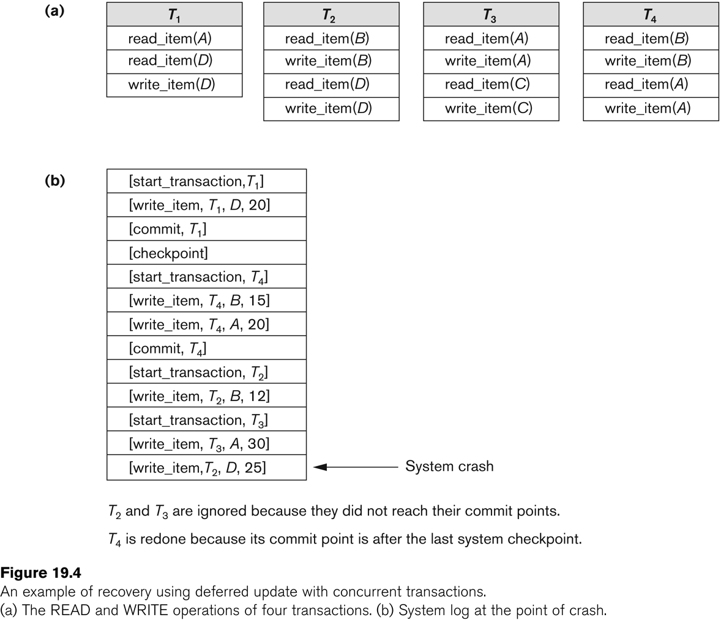
Contd..

Slide 25
Contd..
Two tables are required for implementing this protocol:
–Active table: All active transactions are entered in this table.
–Commit table: This table holds all committed transactions.
During recovery, all transactions of the commit table are redone and all transactions of active tables are ignored

Slide 26
Recovery Techniques Based on Immediate Update
Undo/No-redo Algorithm
–In this algorithm AFIMs of a transaction are flushed to the database disk before it commits.
–For this reason the recovery manager undoes all transactions during recovery.
–No transaction is redone.
–It is possible that a transaction might have completed execution and ready to commit but this transaction is also undone.

Slide 27
Contd..
Undo/Redo Algorithm (Single-user environment)
Recovery schemes of this category apply undo and also redo for recovery.
In a single-user environment no concurrency control is required.
Note that at any time there will be one transaction in the system and it will be either in the commit table or in the active table.
The recovery manager performs:
–Undo of a transaction if it is in the active table.
–Redo of a transaction if it is in the commit table.

Slide 28
Contd..
Undo/Redo Algorithm (Concurrent execution)
Recovery schemes of this category applies undo and also redo to recover the database from failure.
In concurrent execution environment a concurrency control is required.
Commit table records transactions to be committed and active table records active transactions. To minimize the work of the recovery manager check pointing is used.
The recovery performs:
–Undo of a transaction if it is in the active table.
–Redo of a transaction if it is in the commit table.

Slide 29
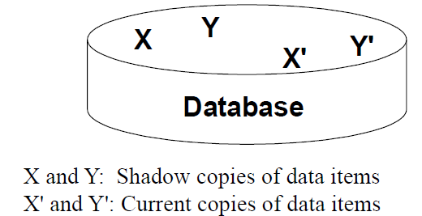
Shadow Paging
The AFIM does not overwrite its BFIM but recorded at another place on the disk. Thus, at any time a data item has AFIM and BFIM (Shadow copy of the data item) at two different places on the disk.

Slide 30
Contd..
The key idea is to maintain 2 page tables during a life of transaction: current page table and shadow page table.
when transaction starts, both page tables are identical. The shadow page table is never changed over the duration of the transaction. The current page table may be changed when transaction performs a write operation.
Shadow page table is used to recover the state of db prior to the execution of transaction in the event of crash or transaction abort.
When transaction commits, the current page table becomes new shadow page table.

Slide 31
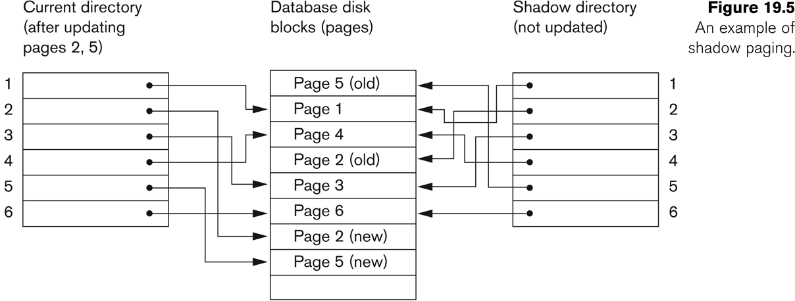
Contd..
To manage access of data items by concurrent transactions two directories (current and shadow) are used.
–The directory arrangement is illustrated below. Here a page is a data item.

